Slide 1
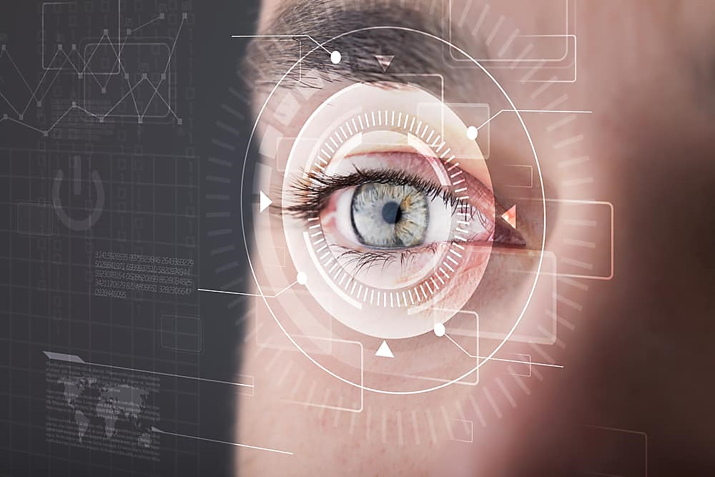
Eyeball-based Cursor Movement Control Using OpenCV
MEMBERS:
SHAIK ABDUL KHADER [161020748064]
SHAIK ANWAR MOHIUDDIN [161020748065]
SHAIK HASAN MOHIUDDIN [161020748305]
Under the guidance of
Ms. Juveriya Ma’am

Slide 2
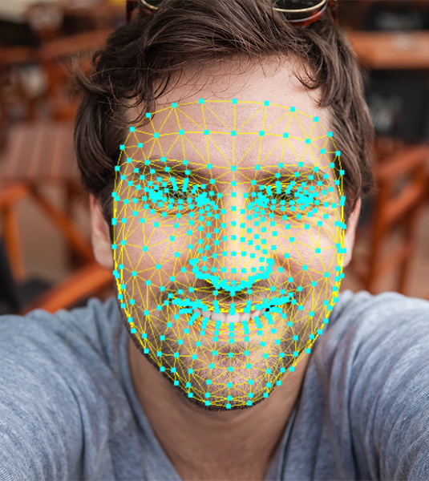
TABLE OF CONTENTS
INTRODUCTION
EXISTING SYSTEM WITH LIMITATIONS
PROPOSED SYSTEM WITH ADVANTAGES
SYSTEM ARCHITECTURE
H/W AND S/W REQUIREMENTS
SCREENSHOTS
APPLICATIONS AND FUTURE SCOPE
REFERENCES

Slide 3

INTRODUCTION
This project introduces an algorithm to carry out the functions of a mouse by providing a hands-free interaction between humans and computers using OpenCV.
It provides an alternative to the traditional mouse computer.
By using different expressions of a face using computer vision and matching it with already stored expression and execute actions as per the move.
This algorithm will help physically disabled people to perform the functions of a mouse using their eye movement.
It allows them to left-click, right-click, move the cursor up, down, left and right.

Slide 4
EXISTING SYSTEM
With advancement in time, now even blind can use the computer using the speech to text option which pronounce the content on the screen. But people who do not have hands cannot use it due to their inability to control mouse and keyboard operations.
In today’s competitive environment everybody needs to be equipped with different set of skills so as to get a job knowledge and usage of computer being a necessity nowadays.
So this caused them to live a miserable life they have to beg and do pitiful activities to keep their lives going. By introducing them to a technology and making them computer compatible will create a ray of hope for them to learn and do some work for their livelihood.

Slide 5
Existing System Disadvantages
Control: Using speech-to-text option, we cannot control the whole computer specifically the mouse.
Limited Language Support: Some speech recognition systems may not support all languages or dialects, limiting accessibility for non-English speakers.
Technological Barriers: Access to speech-to-text technology requires compatible devices and stable internet connections, which may not always be accessible to people with disabilities.
Cost: Advanced speech recognition software may be expensive, making it inaccessible to individuals with limited financial resources.

Slide 6
PROPOSED SYSTEM
Using OpenCV, camera keeps looking for pictures at the rate of 30 frames per second. If it can detect a face then it checks whether the face control function is on or off.
Then if it is enabled, it captures frames for different instructions by the user through the movement of his face as per the directions given.
If he wants to turn the scroll mode ON he/she has to squint both eyes and then move his face up or down for scrolling.
To simply move the cursor user will simply move his head.
For click, he will blink one of his eyes as per the side of the mouse he wants to press.

Slide 7
PROPOSED SYSTEM ADVANTAGES
Hands free computing
Eyes based human computer interaction provide real time eye tracking and eye gaze estimation
User can control mouse events like left click, right click, and double click etc. by movement of eyes
Easy for disabled people to operate

Slide 8
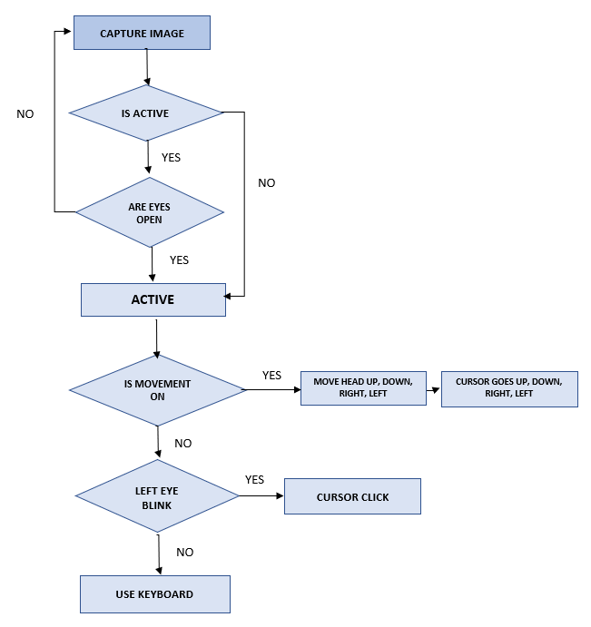
System architecture

Slide 9
HARDWARE AND SOFTWARE REQUIREMENTS
HARDWARE REQUIREMENTS:
PROCESSOR : DUAL CORE 2 DUOs.
RAM : 4GB DD RAM
HARD DISK : 250 GB
SOFTWARE REQUIREMENTS:
OPERATING SYSTEM : WINDOWS 7/8/10
PLATFORM : PYCHARM
PROG. LANGUAGE : PYTHON
FRONT END : PYCHARM

Slide 10
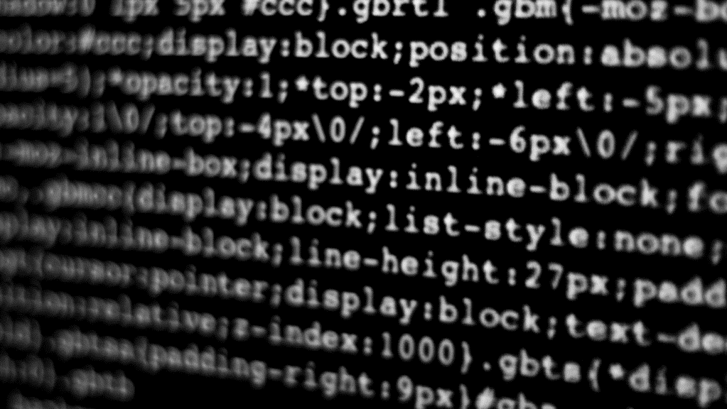
SCREENSHOTS

Slide 11
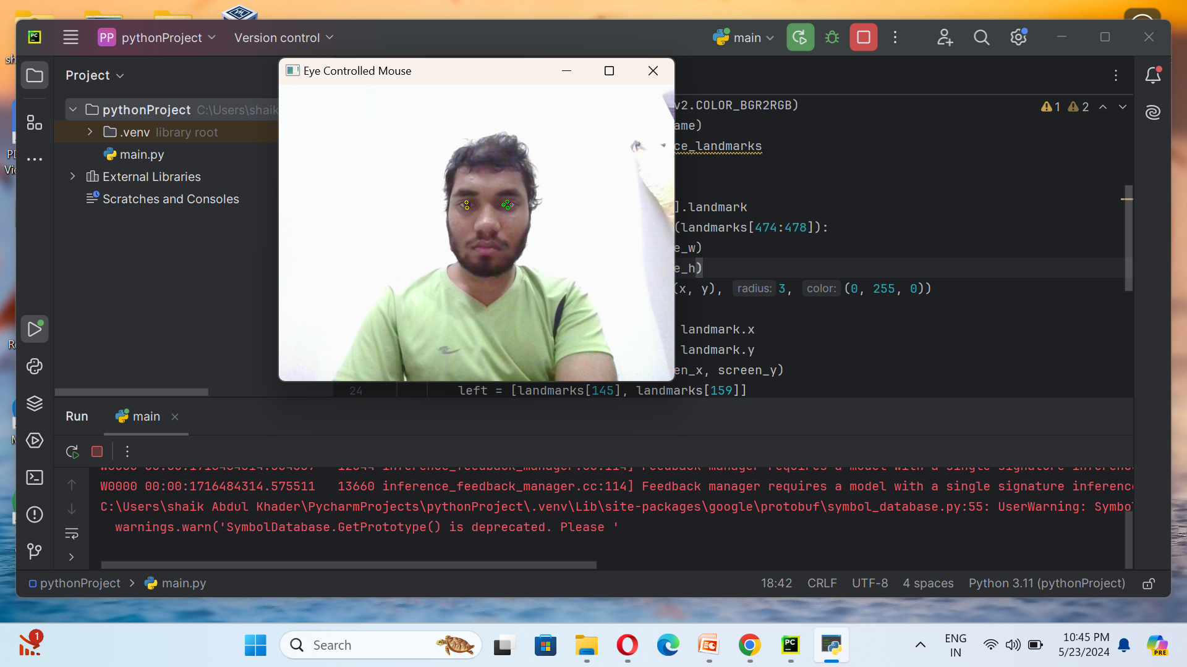
Fig 1. As soon as we run the program, camera starts.

Slide 12
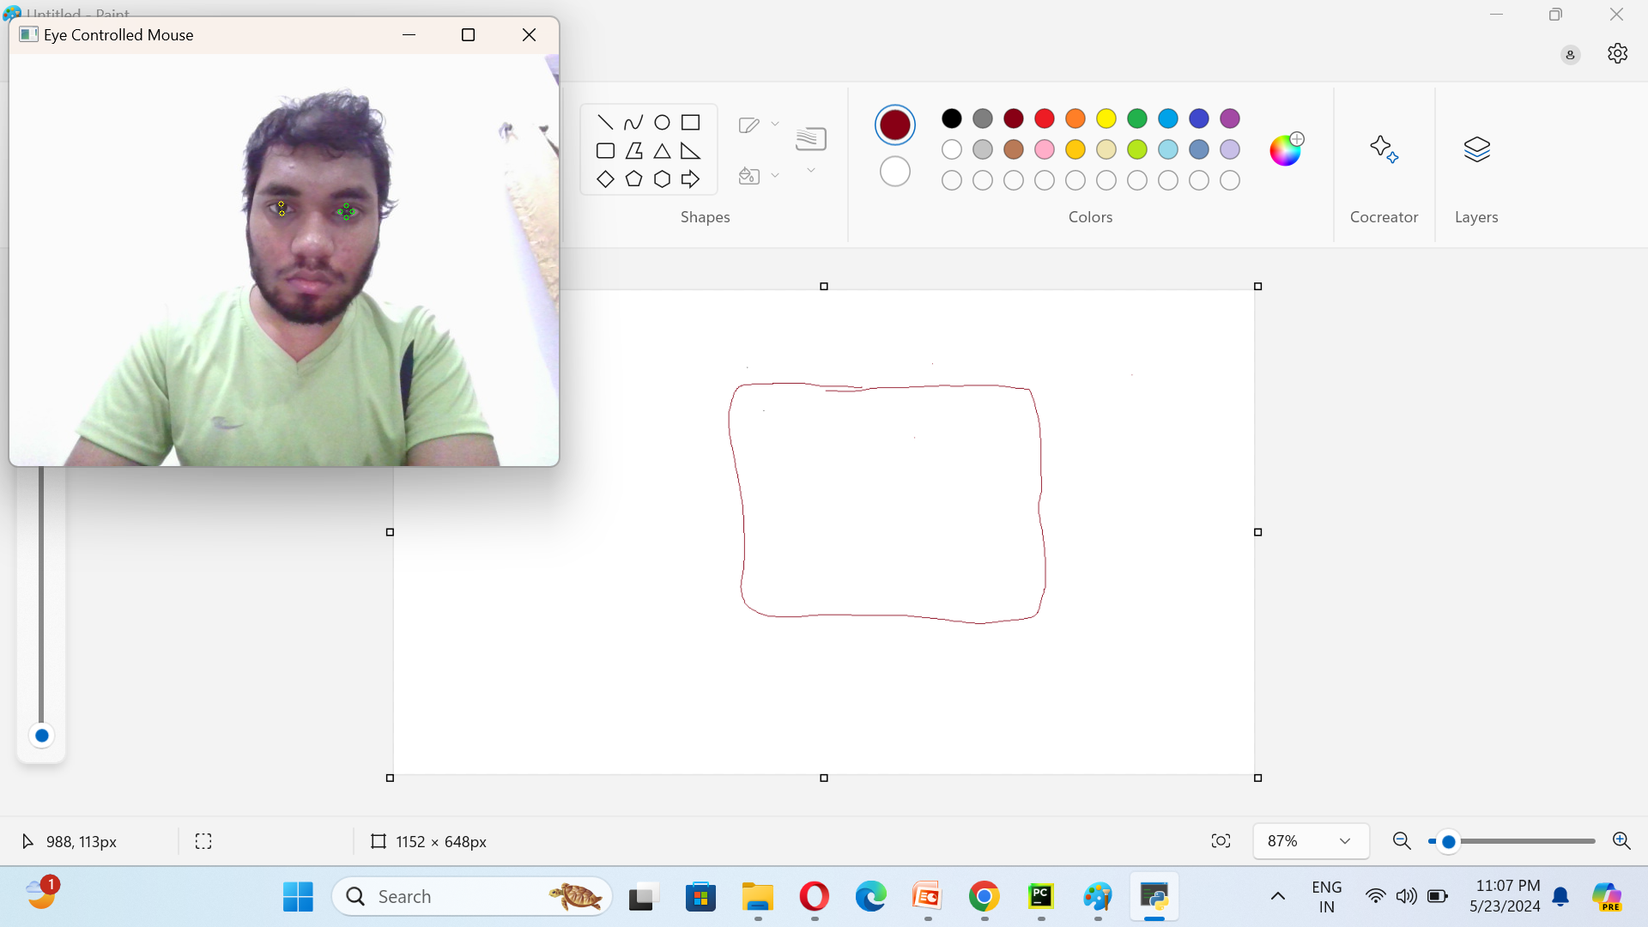
Fig 2. We drew a square in the Paint application using our eyes.

Slide 13

applications
Driver attention detection - It is used to detect the drowsiness of the driver. It will alert the driver to take a break via an alert on.
Gaming Eye tracking technology - Adds to the gameplay experience by allowing you to use your natural eye movements as an additional input in gaming, complementing keyboards, mice and gamepads.

Slide 14
FUTURE ENHANCEMENTS
Further this system can be used in vehicles to observe the laziness of the driver by detecting the drowsiness symptoms like yawning.
It can also be used in gaming and the Internet of Things domain.
We can add the speech module which will be operated by user's mouse and launch on the start of the PC.
Also, we can add scrolling functionality by using face movements and allow this application for playing games and banking sector also

Slide 15
CONCLUSION
A system that facilitates contactless control of mouse is developed and tested. It has an easy and wide application.
Easy mouse cursor movement using face and switching between modes using eyes to enable or disable scrolling, blinking to click.
It has a wide range of applications. It can be used for physically disabled people in their education as this would empower them to control the mouse without hand.
This will lead to job opportunities for disabled people.

Slide 16

THANK YOU!

